Slide 1
Major project review
Title of project
“Development of Mechanical/Structural Engineering tools for Analysis and Post Processing”
At
Bombardier Transportation India Private Limited, Hyderabad
Project guide Internal guide
Mr Giovanni Rungen Prof. D.V.Patel
Mr Saurov Dey
Presented by-
Dhruvin jasoliya(14bme026)

Slide 2
Introduction
Bombardier Transportation is one of the largest train manufacturing industries globally. In India, it has two plants at Maneja and Savli in Vadodara and also has one technical design centre at Hyderabad.
At Bombardier, Hyderabad, modelling as well as simulations are done for various components of train assembly.
The softwares that are used for modelling is DS CATIA and for the simulation of components ALTAIR HYPERWORKS is used.
For the simulations of various components, there are defined set of load cases as per the type of the components i.e. bogie frame, car body or casing for generators in case of electric motor unit(Mumbai local project).

Slide 3
Introduction
The problem is there are many Load cases and the structural engineer has to check the component for every load case and it consumes much time, so there was a need to automize it and make it faster to increase the productivity of work. For this python programming language is used and it is then converted to TCL(tool control Language) which is compatible with hyper works.
For the validation of the results obtained through FEM, a prototype is manufactured and then it is sent to test center. At test center, strain gauges and rosettes are fixed at the predefined nodes which are under high stress as per the simulations results and the readings are taken at these locations under different load cases and then correlation is done between test center data and data obtained from FE analysis.
It is also a time consuming process to correlate results at each and every node, so for this purpose also python programme is created to automize the process of correlation and validation and if there is any problem, changes are done accordingly.

Slide 4
AUTOMATIC LOAD CASE COMBINATION GENERATOR FOR ALTAIR HYPERWORKS
Types of Load cases
Prof LC (w.r.t yield stress of material)
Fat LC (w.r.t endurance limit of material)
Some of the load cases example are;
Vertical+ (lateral right or lateral left)
Vertical+ (rotational right or rotational left)
Vertical + Twist
Fatigue with 20 passengers
Fatigue with 50 passengers
Fatigue with full load

Slide 5
Contd.
The above are some of the load cases out of many cases. For a given set of unit loads, each load case should be entered manually in Altair Hyperworks software which is a tedious job. The task was to automate the input process of different load case combinations for a pre-set unit load cases. This task can be automated by using TCL (Tool Control Language) script, which is the only script that can be recognized by the Altair Hyperworks. To create the TCL script, Python programming language is used. The python code takes the inputs from a csv file containing the load case combinations in a pre-set format and outputs a TCL file which can be recognized by Altair Hyperworks. The TCL code when executed in Hyperworks automatically generates the required load cases. GUI is also made for the same in which we need to enter the required inputs to create the desirable output. (The GUI is in an executable file, i.e., it doesn’t require the python software to be pre-installed to run the software in windows)
Python code for this programme was prepared earlier with the help of Altair Hyperworks Engineer and data provided by Altair.

Slide 6
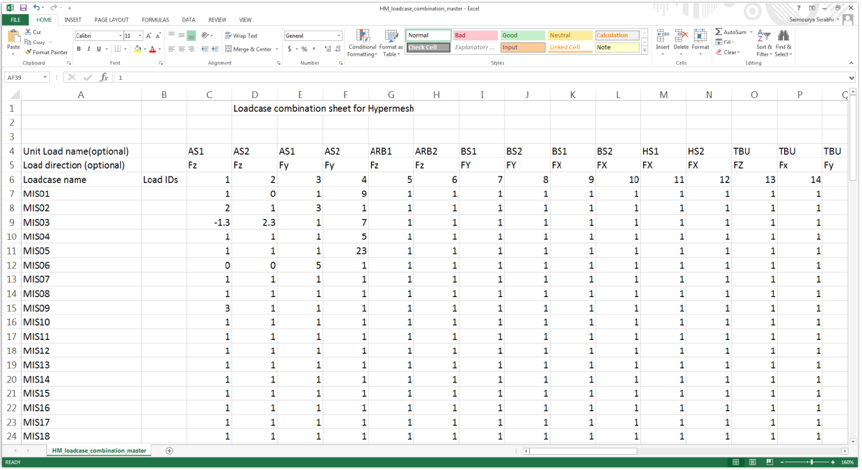
Procedure
Prepare the input csv file containing the load cases for a set of unit loads in the format as shown in the fig. 1.
Fig 1

Slide 7
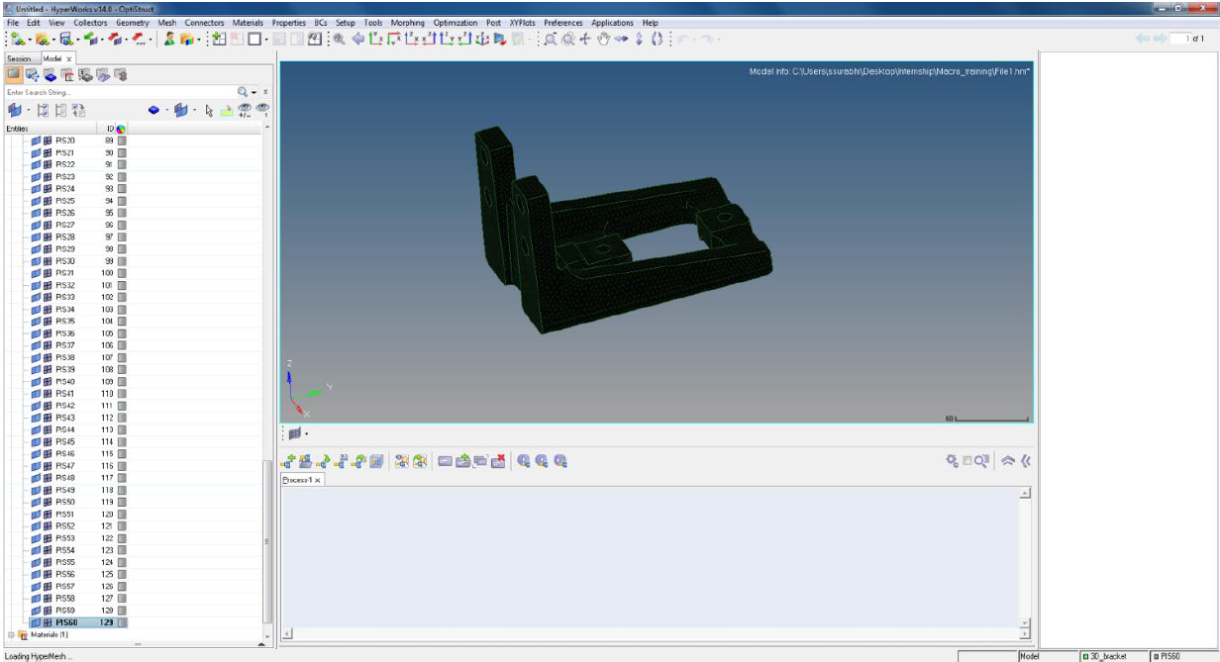
Procedure(contd.)
Generate the TCL file using the programme.
Load the model to Hyper mesh and input the required unit load cases. (Note that the unit load cases here should be same as the ones in the csv file)
Run TCL file in Hyperworks (file>run>script)
All the required load cases are generated in hyper works as shown in figure below.

Slide 8
AUTOMATIC STRESS RESULTS EXTRACTION FOR SELECTED NODES IN ALTAIR HYPERWORKS AND COMPARISON OF SIMULATION DATA WITH TEST CENTRE DATA
While extracting the stresses for a set of selected nodes in Altair Hyperworks software, the stresses for each node can be extracted to a separate csv file. We used TCL (Tool Control Language) script to extract the stresses for each node to a separate csv file. But, as there will be a separate file for each node, it will be not be easy to compare. Hence, the stresses for all the nodes should be consolidated. For this task we used python programming language. Once the consolidated stress sheet is ready, the required stress for each node is separated and the correlation data from the test centre is compared with the stresses from the Hyperworks software. This entire process is automated using python.
This part of the automation project was remaining where python programme had to prepared in accordance to the sample correlation sheet which was used to be prepared earlier. For that nodal stress sheet generator provided by Altair Hyperworks is used along with the code.

Slide 9
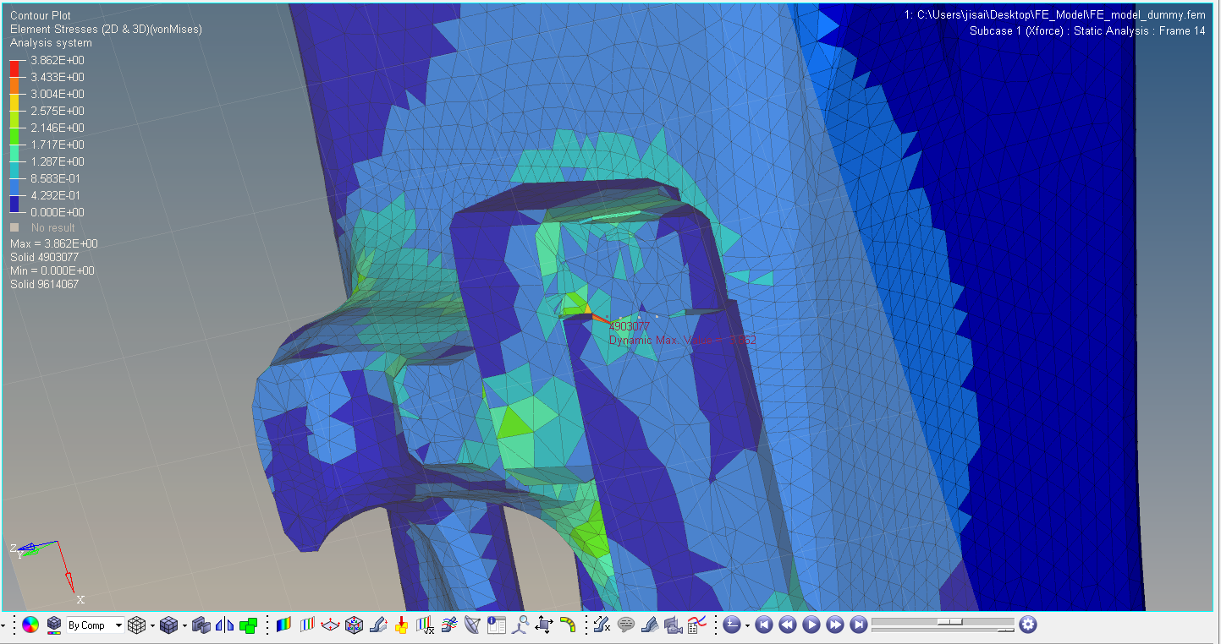
How nodes are selected?
The stress results are obtained in the HyperView after the model setup in the Hypermesh, the nodes having higher stress concentration are segregated and are subjected to the experimental testing to validate the results.
As at the selected nodes, the stress value is higher than other nodes, the validation of the stress value at that nodes determines the overall strength of the structure as they are more prone to failure than other nodes.

Slide 10
Use of strain gauges and rosettes for validation
Strain gauges and rosettes(based on the principle of change in resistivity w.r.t. change in length) are used to measure the strains at the critical nodes which were selected out from the results of FE Analysis. The value of strain is measured under the different load-cases and all the values obtained are then converted into stress through the use of young's modulus of the used material.
Strain gauge is used to measure the strain in one direction only. They are generally used when the critical nodes are along the plane surface where one can easily identify the direction of maximum stress.
While the use of rosettes is generally done when the critical nodes lies along the curvature or any other complex geometries or identification of maximum stress direction is not clear. It has three gauges, two are perpendicular to each other and one is at 45 degree w.r.t. other two. But during correlation the strain at 45 degree gauge is ignored as it will first fail in other two direction rather than 45 degree w.r.t. the primary coordinate axis.

Slide 11
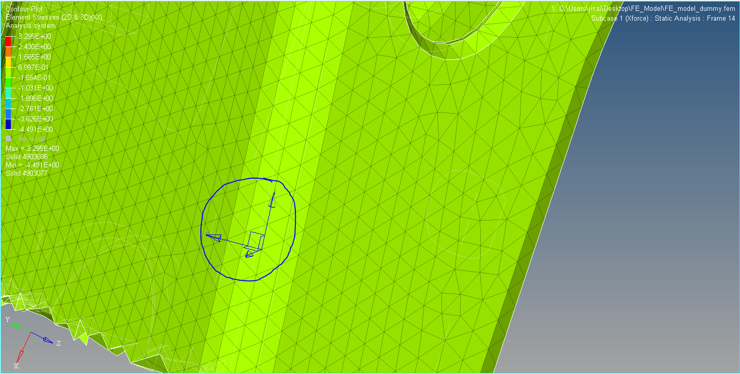
Determination of unique stress direction and use of local coordinate system
For each node, when the values of stress is exported through Hyperworks, it will include all the direction of stresses but validation is done in the direction in which there are maximum stresses of the data has to filtered out and the direction in which the stress is maximum is stated as unique stress direction and it is correlated with the test Centre data.
If the critical node is on the inclined surface then strain gauge cannot be attached parallel to the global coordinate system, hence for that kind of nodes different local coordinate systems are to be defined and stress value in local coordinate has to exported for correlation and in code also provision for same should be there.

Slide 12
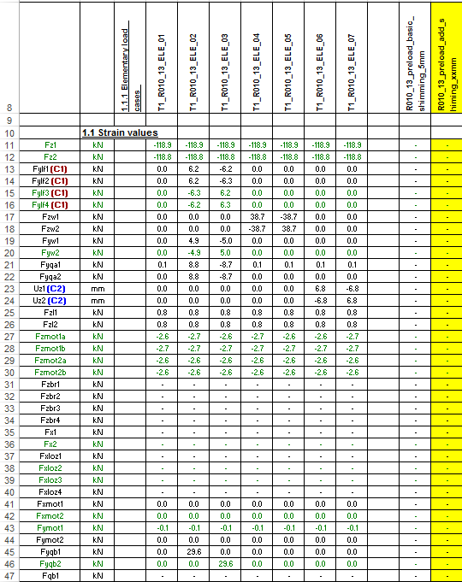
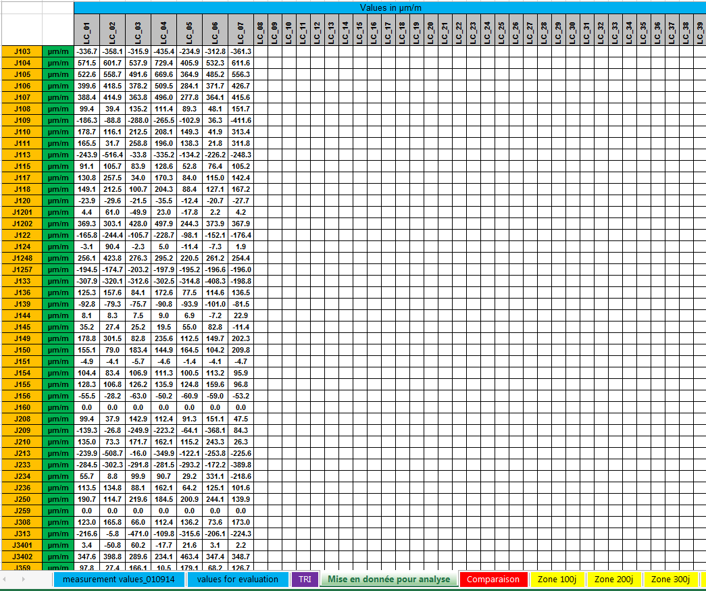
Sample Correlation Excel File
First of all, the load is applied on the structure as per the load cases provided to the test Centre and excel sheet is prepared as shown in the left figure.
In second figure, the corresponding strain values for the different load cases are recorded for further correlation.
Figure for load case
Figure for strain values on gauges

Slide 13
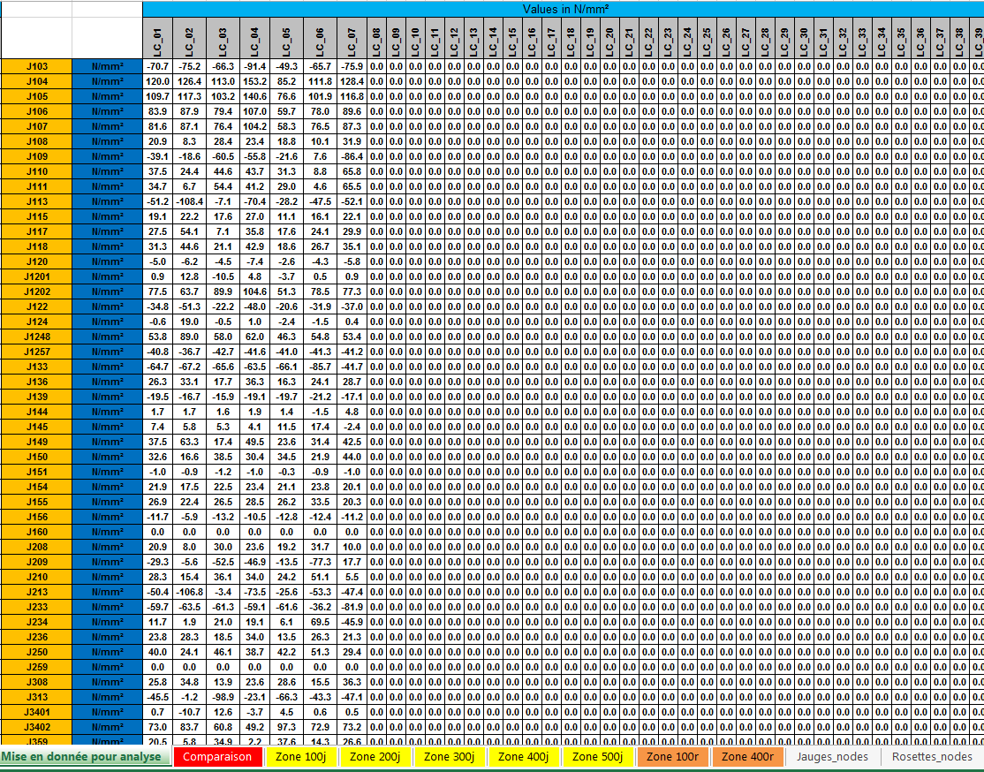
Contd.
The value for corresponding stresses are obtained through the elasticity modulus of the material.
Then values of stress at each gauges is recorded for further correlation.

Slide 14
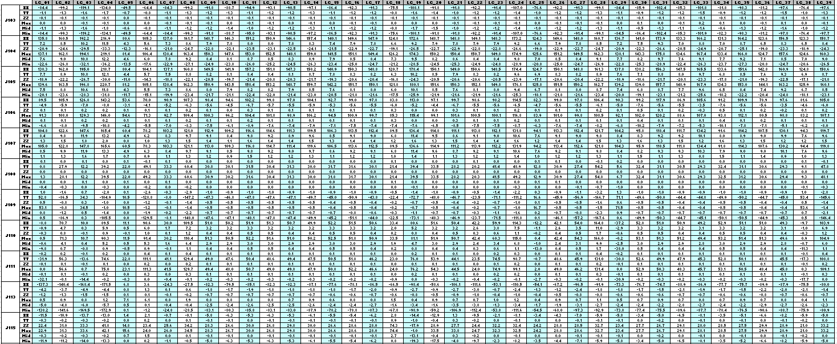
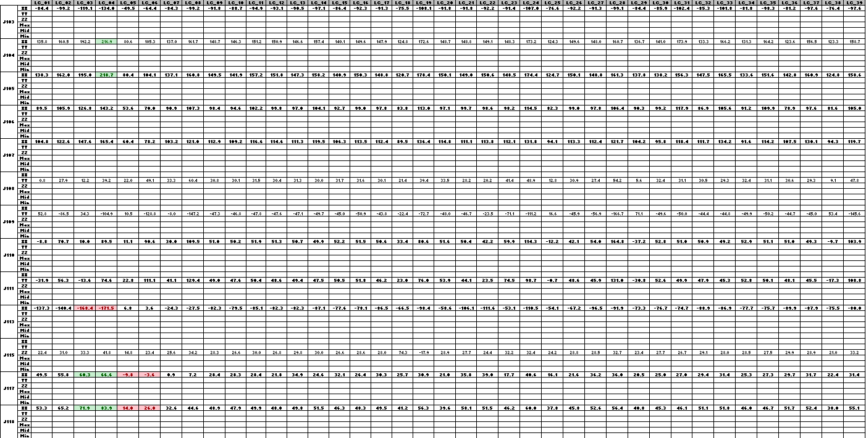
Contd.
The values of stresses in all direction along with principal stresses are obtained at each node through FEA and it is recorded in excel as shown in the figure.
Out of all stresses values the unique stresses are separated out as shown in the figure for correlation.
Stress value for each node through FEA
Filtering the value of unique stresses

Slide 15
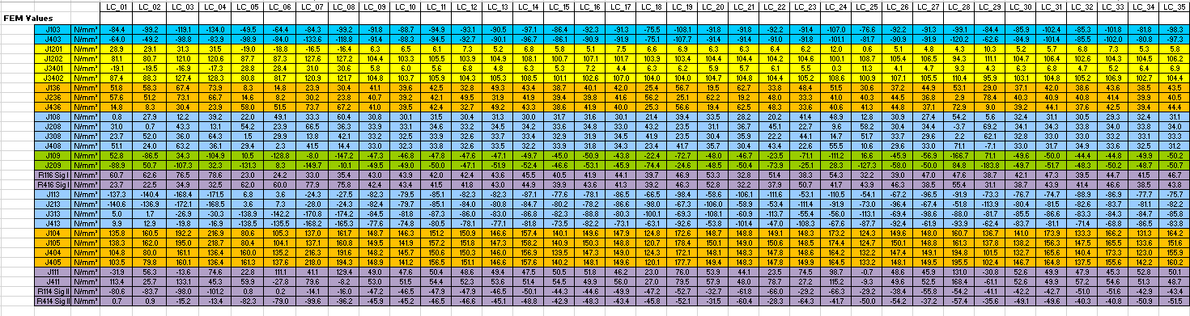
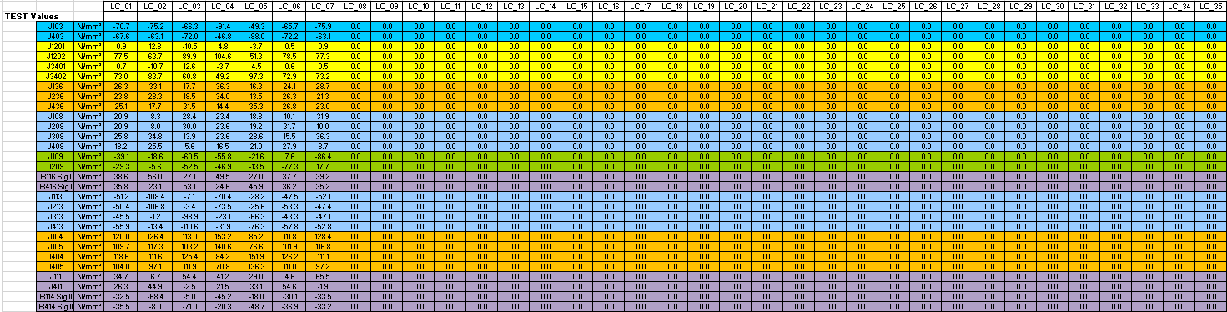
Contd.
The values obtained from the FEA is recorded in excel as shown in the figure after filtering out the unique stress values.
The values obtained from the test Centre is recorded for correlation and validation of the results obtained from FE analysis.

Slide 16
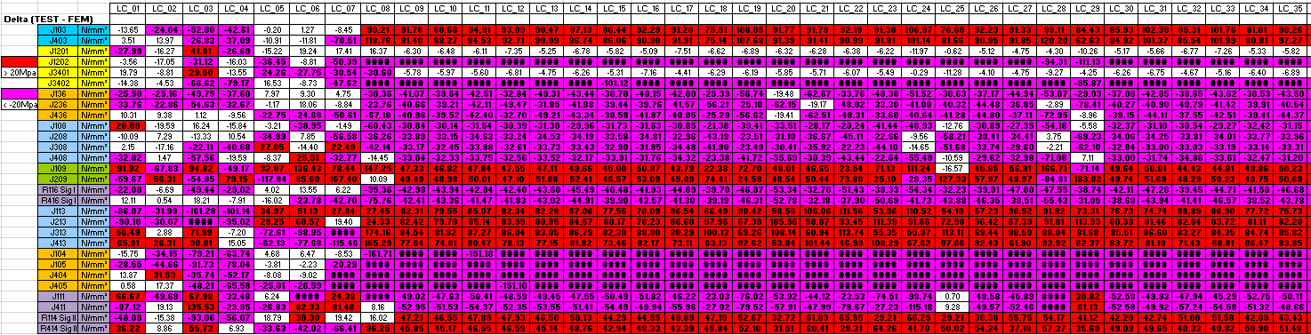
Contd.
The final correlation is done between the stresses values obtained from FE analysis and from test Centre.
The problem in correlating this way was that stresses values were obtained through software but they had to be arranged and filtered manually in the final correlation sheet which was a time consuming task and automation was needed for this which was achieved using python programme.

Slide 17
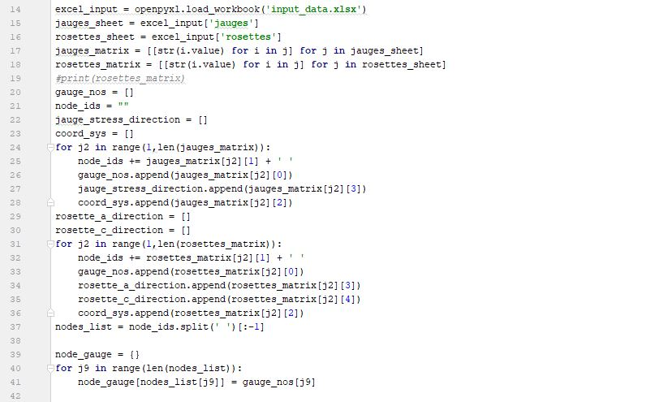
Python Code for correlation
In python, openpyxl module is used, which used for reading, creating and writing in excel files.
In this part of program, input_data excel is read by the program and there are two worksheets jauges and rosettes. So values from each cell of both worksheets is read and recorded by the code.
Different variables are there for storing the data read from the excel file such as gauge_nos,node_ids,Jauge_stress_direction,Coord_sys,etc.
.append function is used to add all the data into the assigned variables.

Slide 18
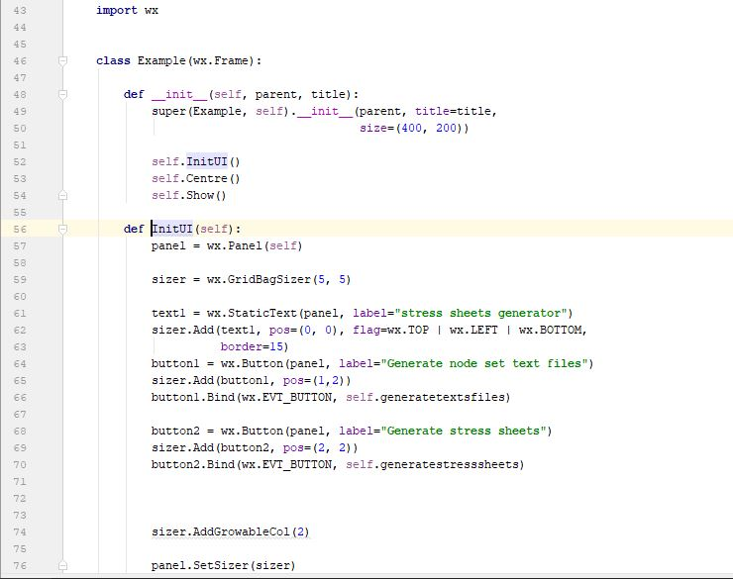
Contd.
In this part, wx module is used for GUI(graphical user interface)preparation of the code.
The GUI will have two buttons. First will be, generate node set text files for generating text files for nodes in global and local coordinate system. Second is, generate stress sheet for generating final correlation excel sheets.
The variable used for executing first button press is named generatetextfiles, similarly for executing second part of code variable used is generatestresssheets.

Slide 19
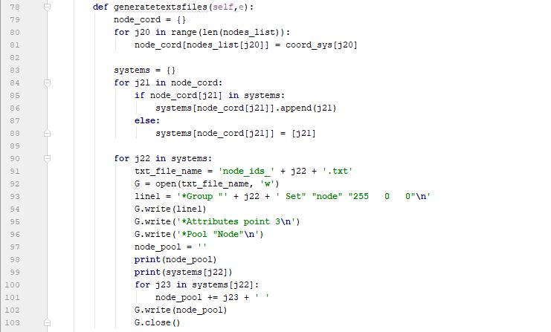
Contd.
From in input_data excel file, all nodes are stored along with their coordinate system.
A variable named systems is defined, if the coordinate system is already present in the code, the node will be added in that set else a set containing new coordinate system is corresponding to the node will be created.
After that, the text files for each coordinate system is made containing all the corresponding nodes along with the syntax required to be imported in Hyperworks as node set text files.
The text files generated will be used later for generating stress values at corresponding nodes in their pre defined coordinate system which will be used as input for second part of code.

Slide 20
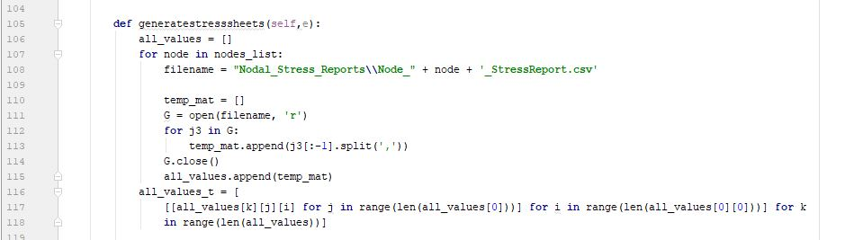
Contd.
Now, from the node text files which were generated earlier are used for preparing excel files containing stress data of each subcase.
Nodes list contains data about all nodes from input file and it is used to read all the node excel files with the help of two variables.

Slide 21
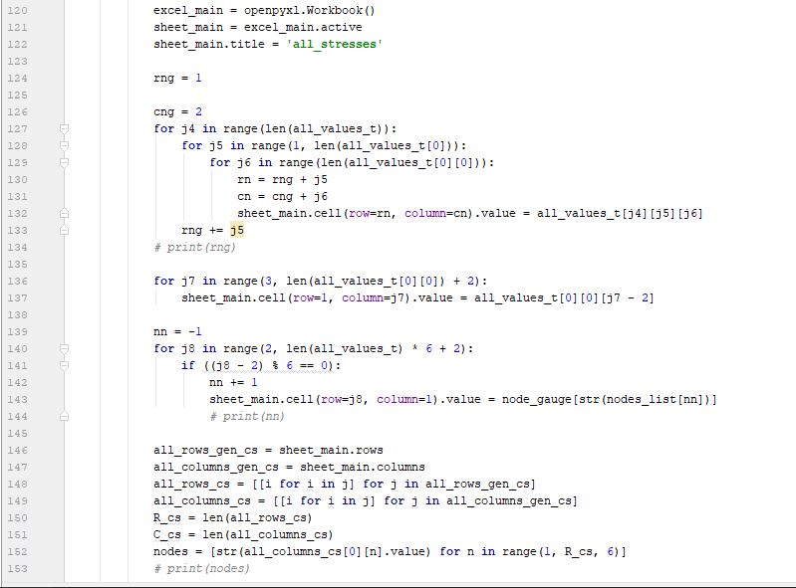
Contd.
A new worksheet is generated in the excel_main named All_stresses.
The data stored in the variable earlier from the node excel files is recorded in this file as per the required format including stresses in XX,YY,ZZ,P(major),P(mid) and P(min).
Further, new variables are defined for creating other excel worksheets.

Slide 22
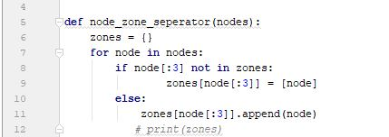
Contd.
A function is defined for separating the nodes in jauges and rosettes along with their assigned zone.
The values of node are taken from nodes list and if the zone already exist it will add that node to that list or else it will create new zone.

Slide 23
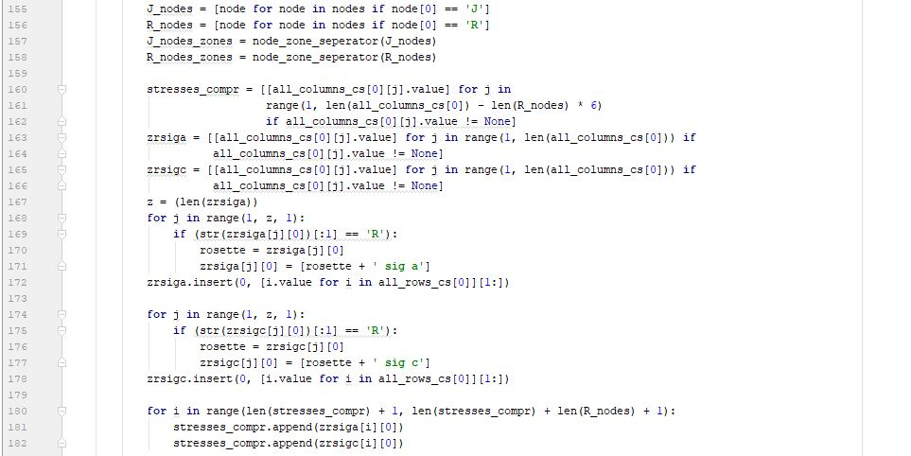
Contd.
Node zone separator function is use to separate R-zone and J-zone.
A new variable is defined for next sheet and also each rosette has to be separated in two different direction that is sig a and sig c.
The above task is done using two variables and reading value of each variable alternatively.

Slide 24
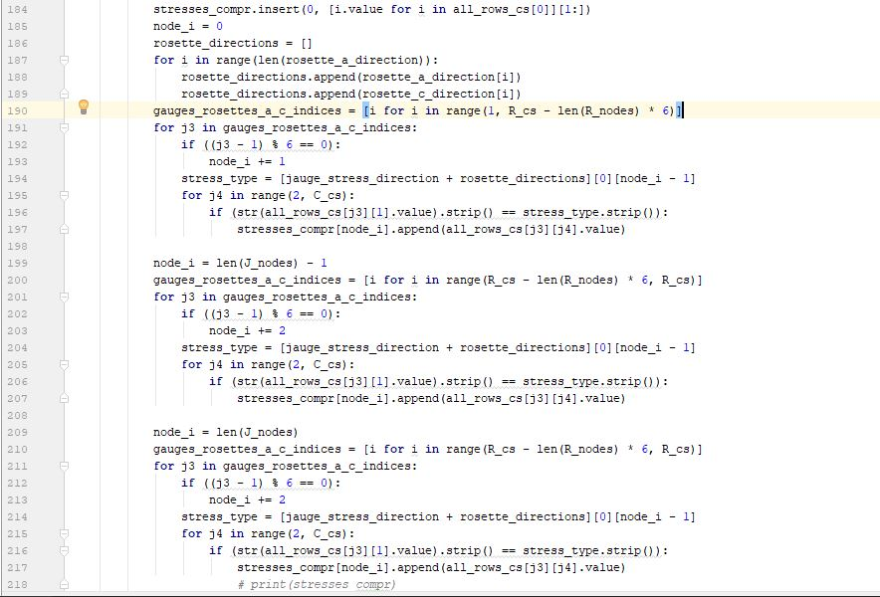
Contd.
Now, the unique stress direction for all nodes is read and stored in a common variable.
For, jauges nodes are directly assigned with their stress direction and its corresponding values.
For rosettes nodes the loop has to be runned twice as for each node there are two unique stress direction i.e. sig a and sig c.

Slide 25
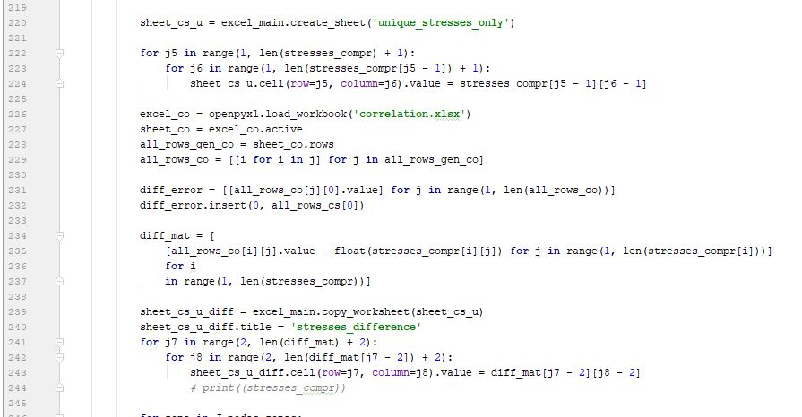
Contd.
A new excel worksheet is generated named unique stress only for storing stress values which is to be correlated with test Centre data.
Values of test centre data is obtained from coorelation.xlsx file and it is stored in a variable for further operation.
A new excel worksheet is generated named stress difference where difference between stress values obtained from FE Analysis and Test Centre data.

Slide 26
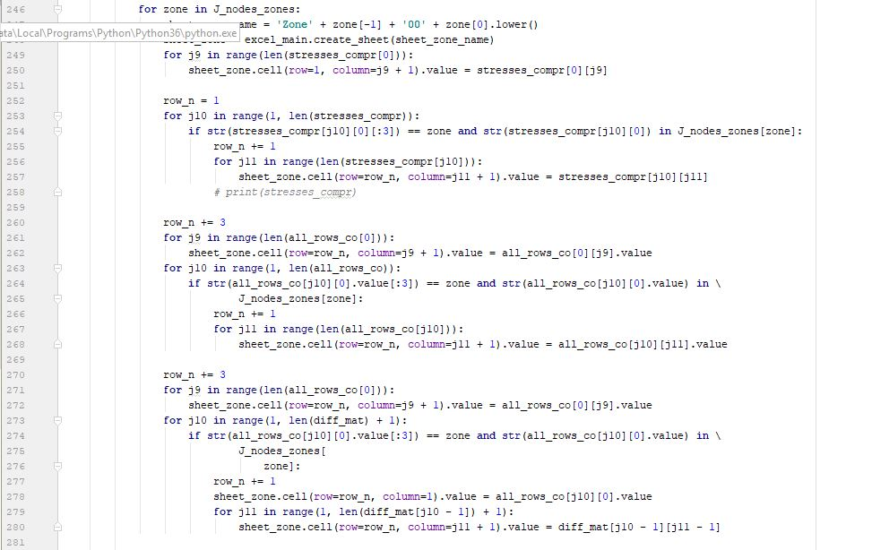
Contd.
Now, A separate Jauges node sheet is created for each jauge zone and nodes belonging to it.
First of all, unique stress values for each node belonging to that zone is added.
Then the values obtained from test centre data for corresponding nodes is added and at last the stress difference is added.

Slide 27
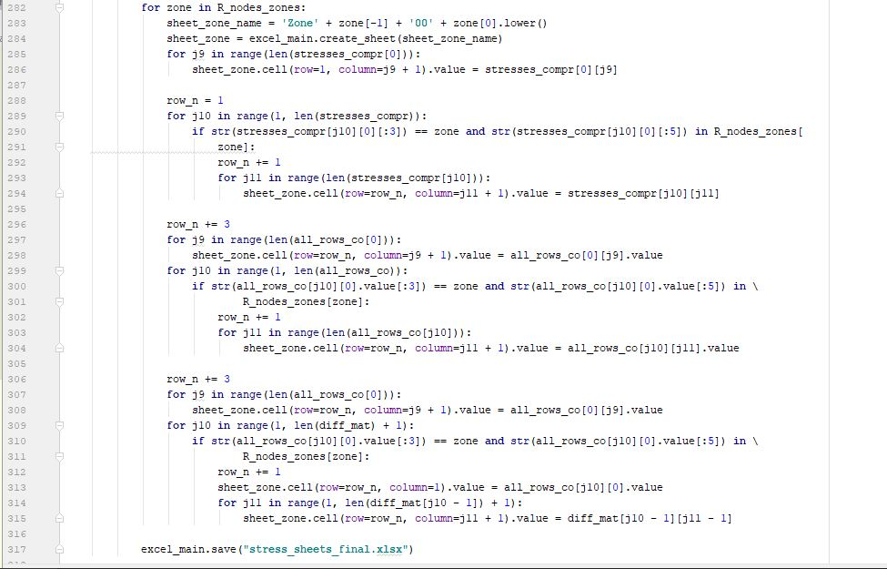
Contd.
The same procedure is followed for R-zone nodes.

Slide 28
Test Run of the code

